Slide 1
Heroku
Cloud Application Platform

Slide 2
What is Heroku?
A multi-language cloud application platform built on Amazon EC2
Supported languages:
Ruby
Java
Clojure
Scala
Python
Node.js

Slide 3
History of Heroku
Developed since June, 2007
Salesforce.com completes acquisition of Heroku – January, 2011
Cedar Stack in public beta – May, 2011
Matz joins Heroku – July, 2011
Facebook and Heroku – September, 2011

Slide 4
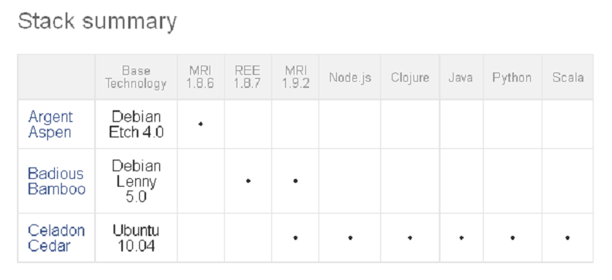
Stacks
Stacks are deployment environments including operating system, language runtime and libraries

Slide 5
Forget servers
Dynos:
Fully-isolated execution environments
Features:
Elasticity
Intelligent routing
Process management
Distribution and redundancy
Isolation

Slide 6
The Process Model
Process types:
Web processes
Workers
One-off admin processes
Processes are defined for each application in a special file called Procfile
Every processes are executed on dynos

Slide 7
Easy deployment with Git
Init Git repository:
git init
Adding changes to the index:
git add .
Commit to local repo:
git commit –m ”commit message”
Create your application on Heroku:
heroku create myapp --stack cedar
Commit to Heroku’s remote repo:
git push heroku master

Slide 8
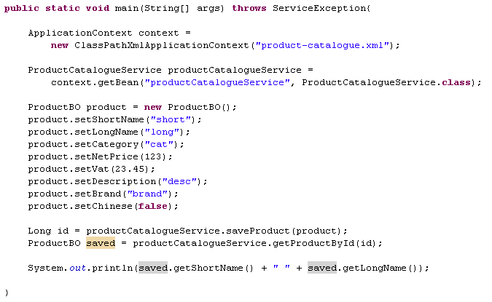
In a standalone java application

Slide 9
Dependency injection revisited
Setter injection
<property name="propertyName" ref=„beanName"/>
p:propertyName="value"
p:propertyName-ref="beanName"
Constructor injection
<constructor-arg index="0" ref="something"/>
<constructor-arg index="1" ref="somethingElse"/>

Slide 10
Bean attributes
Instantiation/destruction related attributes:
Init-method
Factory-method
Factory-bean
Destroy-method
Lazy-init
Scope (singleton, prototype)
Inheritence related attributes:
Abstract
Parent
Automatic dependency injection related attributes:
Autowire (byName, byType, constructor, no)
Autowire-candidate
Primary

Slide 11
Special interfaces
InitializingBean (afterPropertiesSet method)
DisposableBean (destroy method)
ApplicationContextAware (setApplicationContext method)
BeanNameAware (setBeanName method)
FactoryBean
BeanPostProcessor
BeanFactoryPostProcessor

Slide 12
Annotation based configuration
Enable annotations in XML
Use annotations on classes
@Component
@Repository
@Service
@Controller
Use annotations on attributes
@Autowired
@Required
@PostConstruct
@PreDestroy

Slide 13
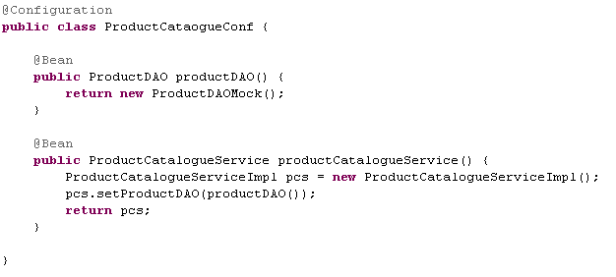
Java based configuration

Slide 14
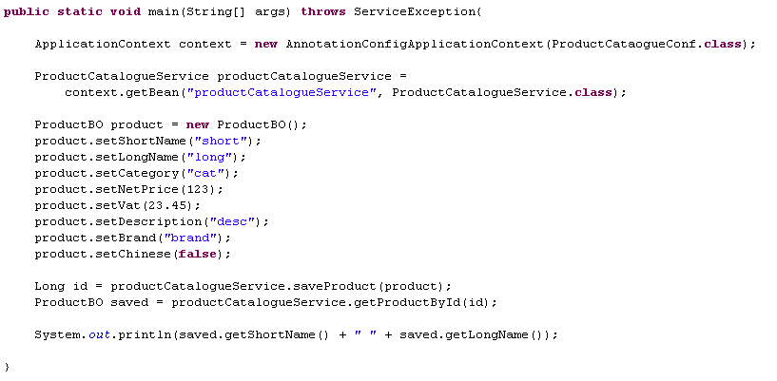
Java based configuration

Slide 15

JUnit 4.5+ and Spring
Configure JUnit to use Spring
Inject dependencies with @Autowire
Use Spring mock objects
JNDI
Servlet
Portlet

Slide 16
Explore the project

Slide 17
Documentation
http://www.springsource.org/documentation
http://blog.springsource.com/category/green-beans/
http://static.springsource.org/spring/docs/3.0.x/spring-framework-reference/html/beans.html
http://static.springsource.org/spring/docs/3.0.x/spring-framework-reference/html/testing.html
http://martinfowler.com/bliki/InversionOfControl.html
http://docs.codehaus.org/display/PICO/IoC+Types

Slide 18
Questions?

Slide 19
Thanks for Your Attention
Spring framework — The IoC container
By
Bertalan Kis
Software Developer
EPAM Systems
41 University Drive, Suite 202 | Newtown, PA 18940
p: +1 267 759 9000 | f: +1 +1 267 759 8989 | e: info@epam.com | w: www.epam.com

